Slide 1

CIS 600 - Wine Quality Prediction using Machine Learning Algorithms
Yuexin Yu,
Jingwen Ling,
Vaidy Krish
College of Engineering & Computer Science

Slide 2
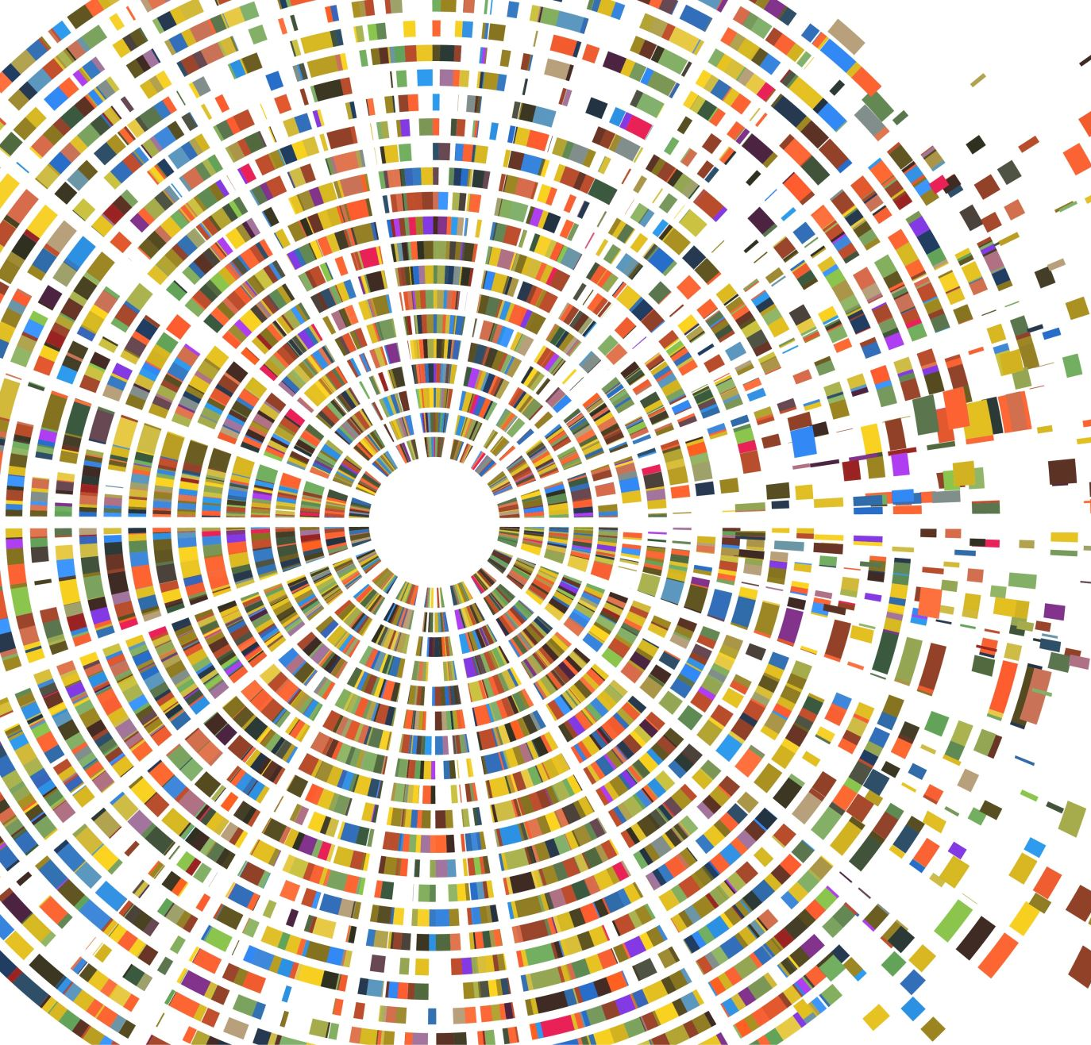
Project Introduction and Objective

Slide 3

Wine
Wine is an alcoholic beverage made with the fermented juice of grapes
Four Types of Wine
Red wine
White wine
Rose wine
Sparkling wines/champagne.

Slide 4
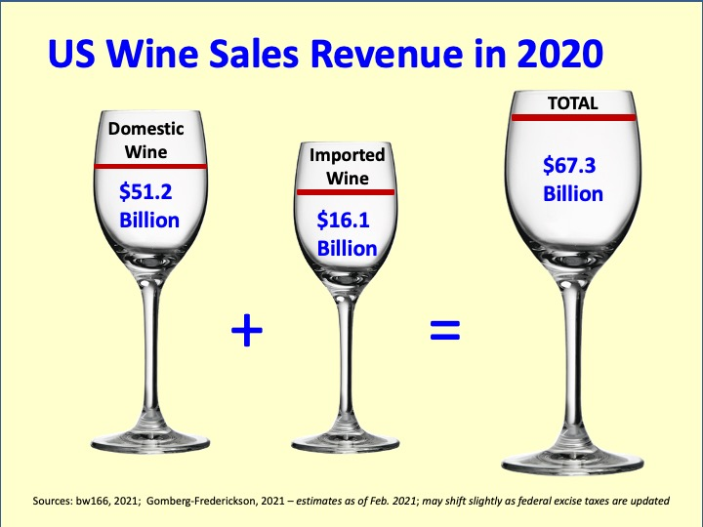
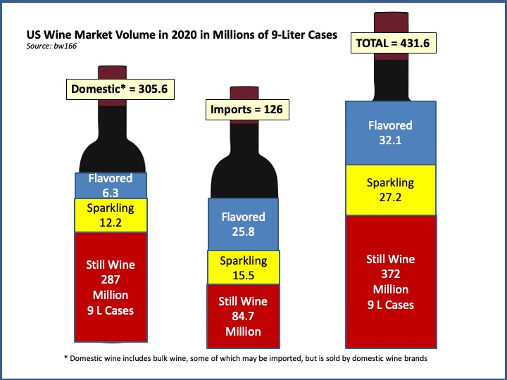
Wine Market in the U.S.
The USA is the world’s largest wine market, with the largest population of regular wine drinkers.
In 2020, the USA market consumed 126 million cases of imported grape wine valued at nearly $US 16 billion.

Slide 5
Objective
Explore and visualize the dataset :
To predict the quality of wine on a scale of 0 to 10.
Which variables are most significant.
Build using various machine learning models predict …..
Generate a set of insights and recommendations that will help the business to understand which wine has the highest quality.

Slide 6
Data Information
Attributes’ information about the datasets (winequality-red.csv and winequality-white.csv)
Input variables (based on physicochemical tests):
1 - fixed acidity
2 - volatile acidity
3 - citric acid
4 - residual sugar
5 - chlorides
6 - free sulfur dioxide
7 - total sulfur dioxide
8 - density
9 - pH
10 - sulphates
11 – alcohol
Output variable (based on sensory data):
12 - quality (score between 0 and 10)

Slide 7
Data Preparation Steps Involved

Slide 8
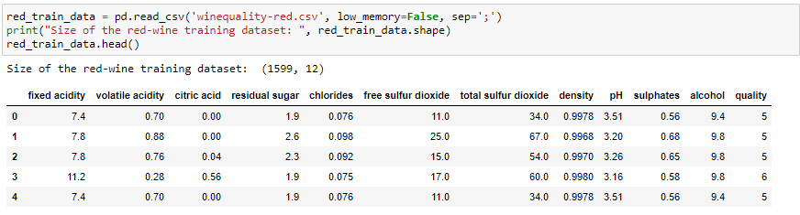
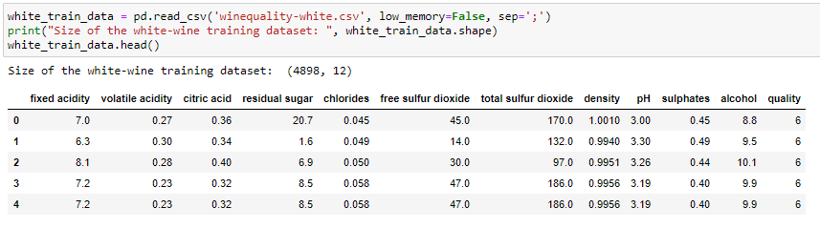
Data Preparation & Exploratory Data Analysis
The maximum rating of wine is 9 and the third quartile value is 6 i.e. at least 75% of wines have rating 6 or below.
There might be outliers in data where the wines have high sulfur dioxide (free sulfur dioxide and total sulfur dioxide) content as there is a big difference in 3rd quartile and maximum values.
Most wines are on a pH scale between 3 and 4.

Slide 9
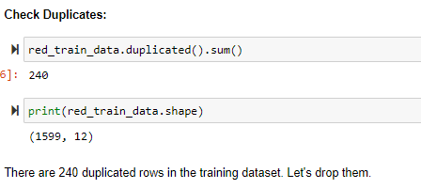
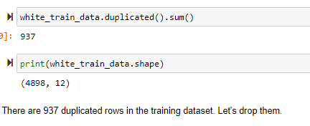
Data Preprocessing and Cleaning - 1, Check and Remove Duplicates
We found 240 duplicated rows in the red wine dataset and 973 duplicated rows in the white wine dataset.
We will drop them out of the training dataset.

Slide 10
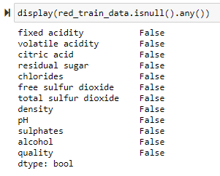
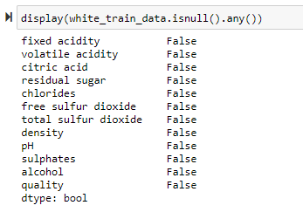
Data Preprocessing and Cleaning - 2, Check Missing Data
There are no missing data rows in both data set.

Slide 11
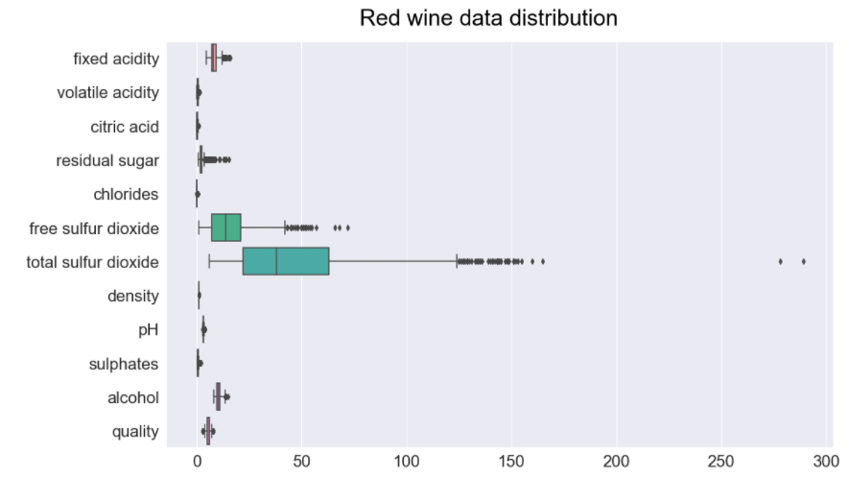
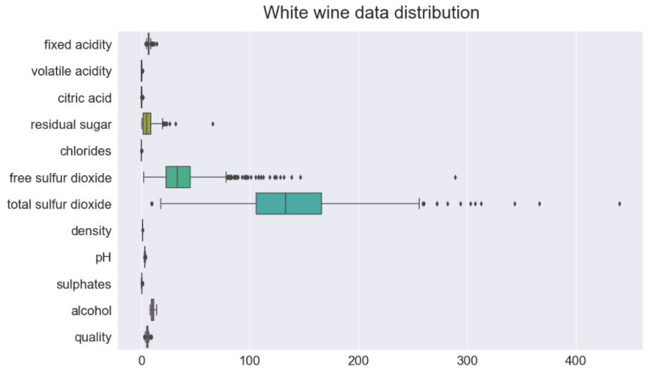
Data Preprocessing and Cleaning - 3, Check and Remove Outliers
Red wine data set:
Remove outliers on ‘free sulfur dioxide’ and ‘total sulfur dioxide’ columns.
White wine data set:
Remove outliers on ‘residual sugar’, ‘free sulfur dioxide’ and ‘total sulfur dioxide’ columns.

Slide 12
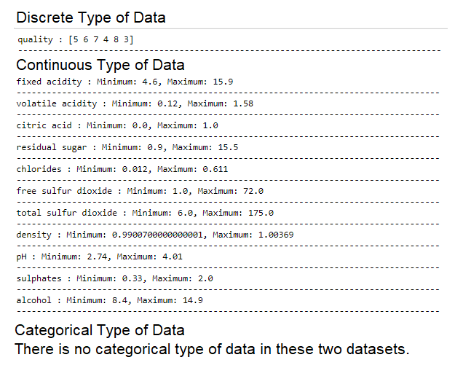
Data transformation and preparation - Explore Different Data Types

Slide 13
Exploratory Data Analysis and Key Insights

Slide 14
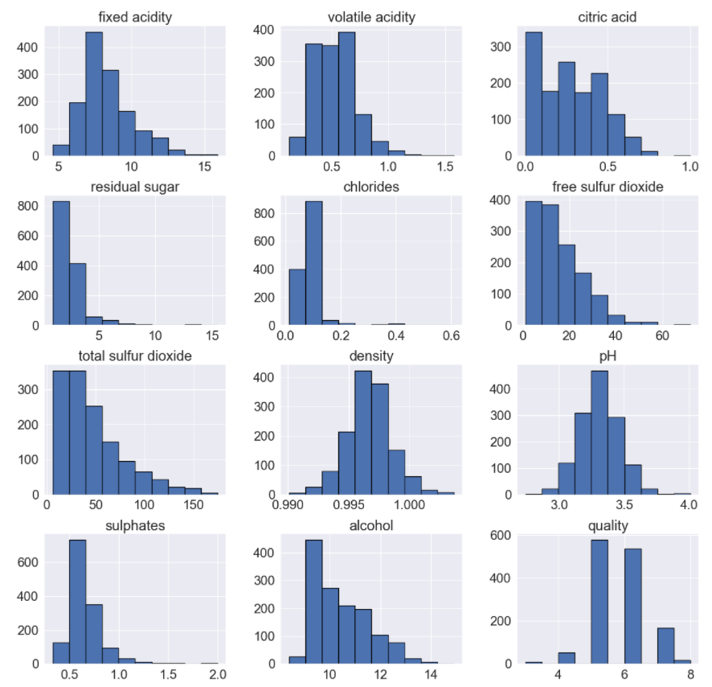
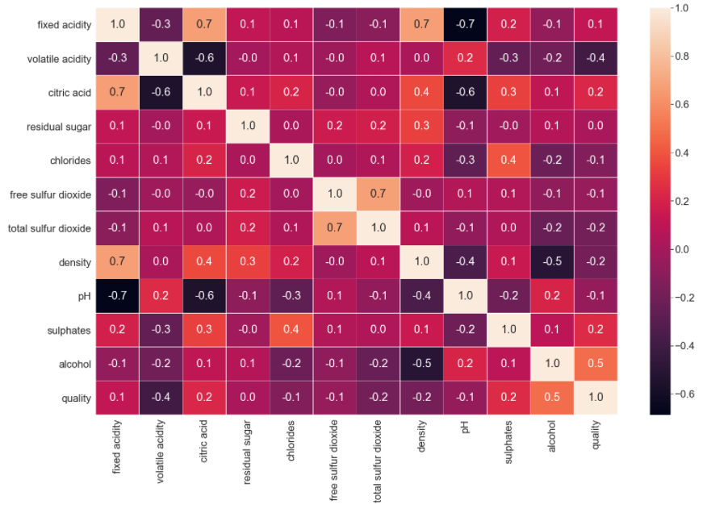
Exploratory Data Analysis (EDA): - Explore Numerical Features – Red wine dataset
From the heatmap, we can see the high negative correlation on volatile acidity, total sulfur dioxide, density with red wine quality, and high positive correlation on citric acid, sulphates, alcohol with red wine quality.

Slide 15
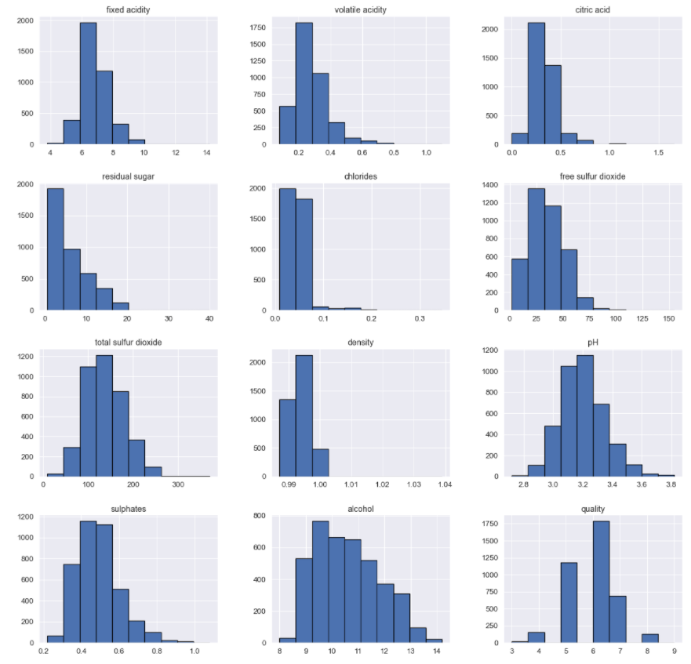
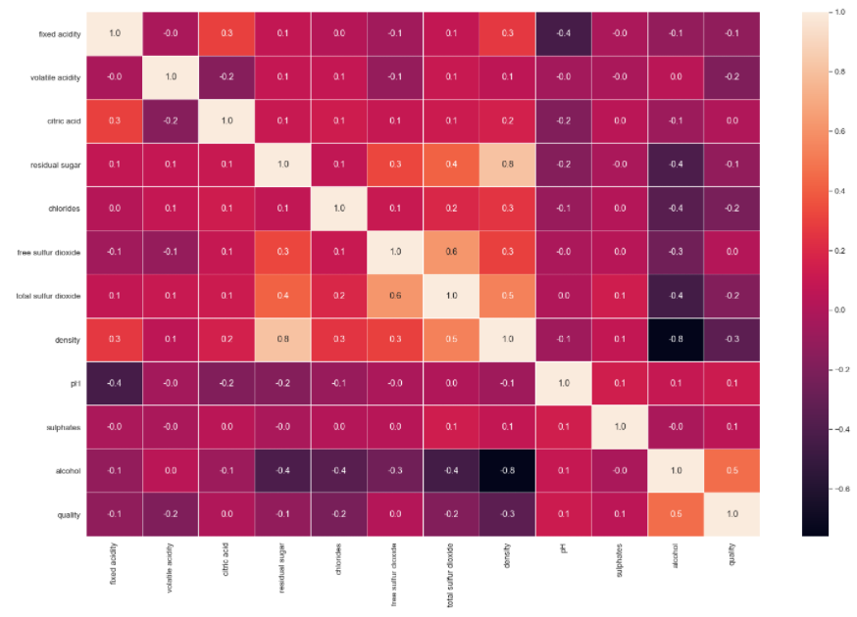
Exploratory Data Analysis (EDA): - Explore Numerical Features – White wine dataset
From the heatmap, we can see the high negative correlation on volatile acidity, chlorides, total sulfur dioxide, density with white wine quality, and high positive correlation on alcohol with white wine quality.
Fixed acidity has a strong positive correlation with citric acid and density.
The total sulfur dioxide and free sulfur dioxide have a strong correlation.
The quality of wine shows a moderate correlation with alcohol.

Slide 16
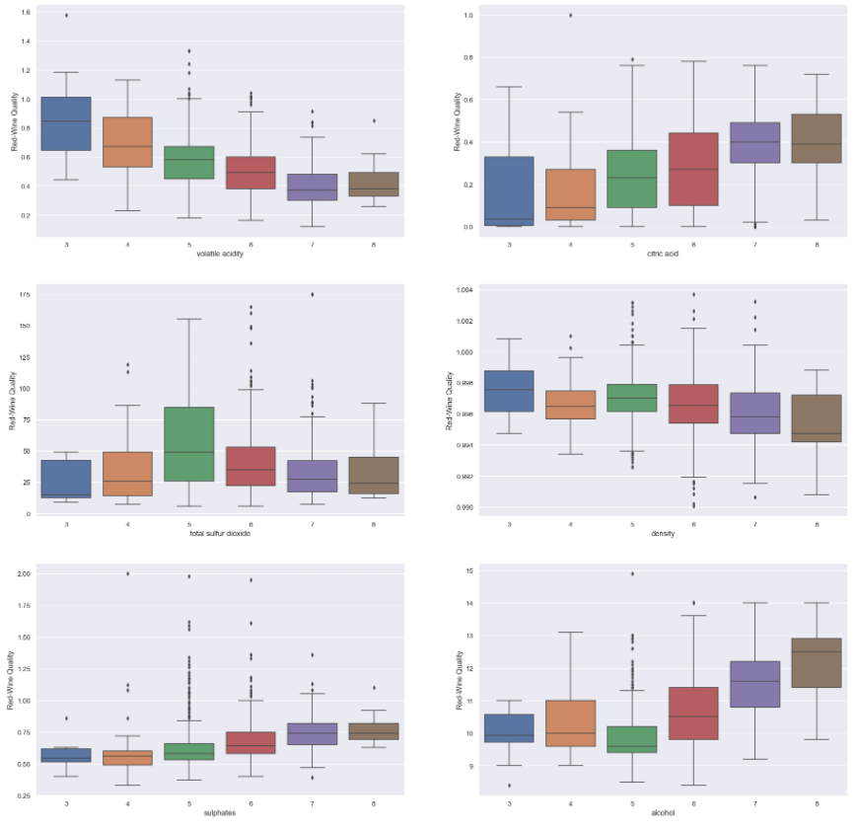
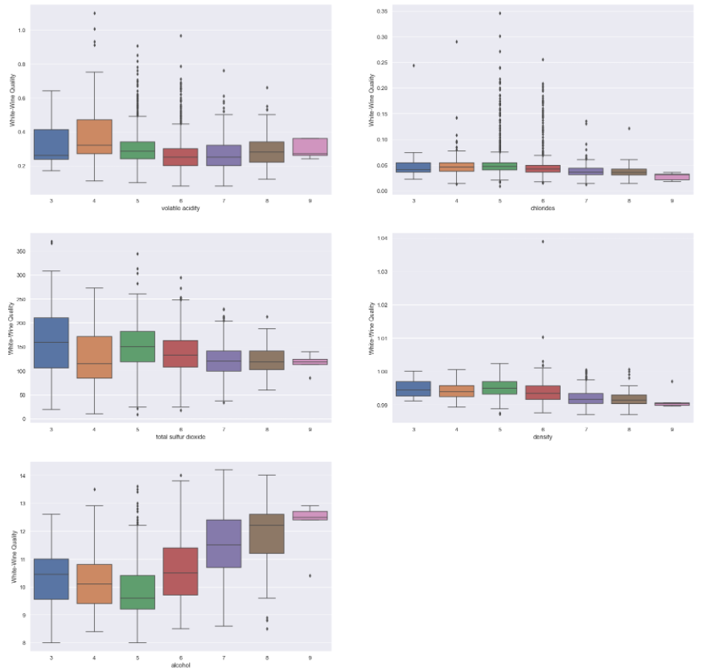
Exploratory Data Analysis (EDA): - Data Insight – Suggestion for manufacturer
Red wine: we can see increasing on volatile acidity, total sulfur dioxide, density will reduce the red wine quality, increasing on citric acid, sulphates, alcohol will improve the red wine quality.
White wine: we can see increasing on volatile acidity, chlorides, total sulfur dioxide, density will reduce the white wine quality, but increasing on alcohol will improve the white wine quality.

Slide 17
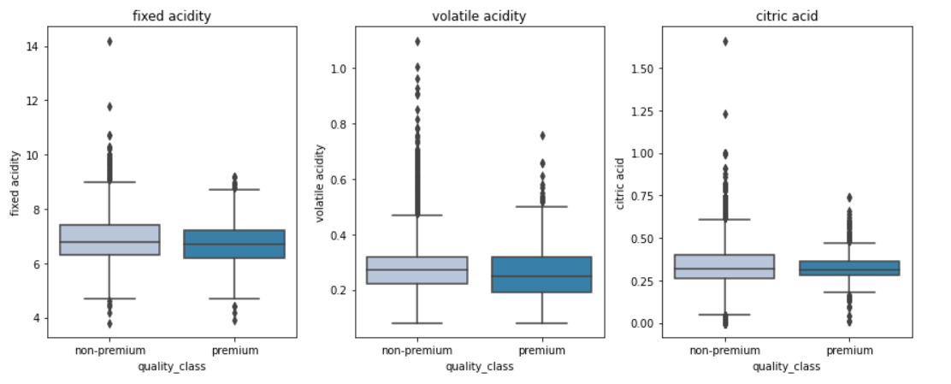
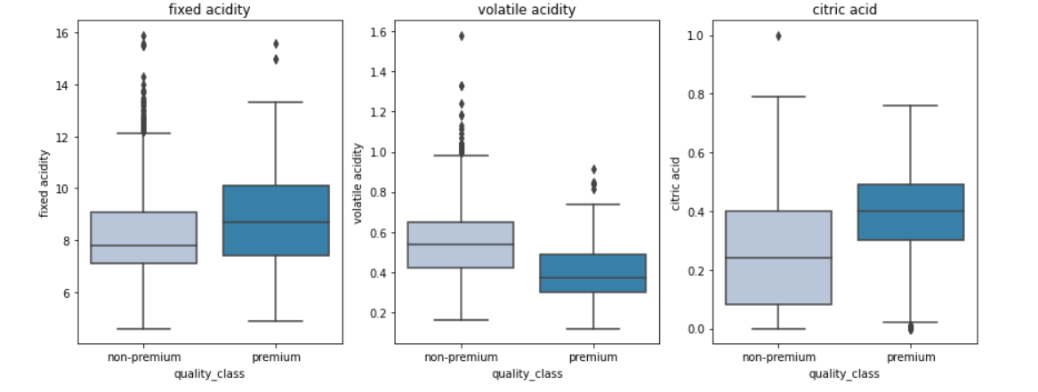
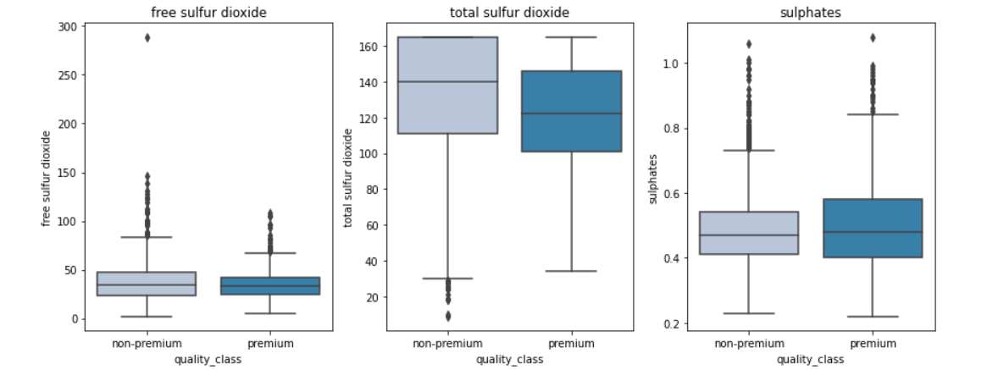
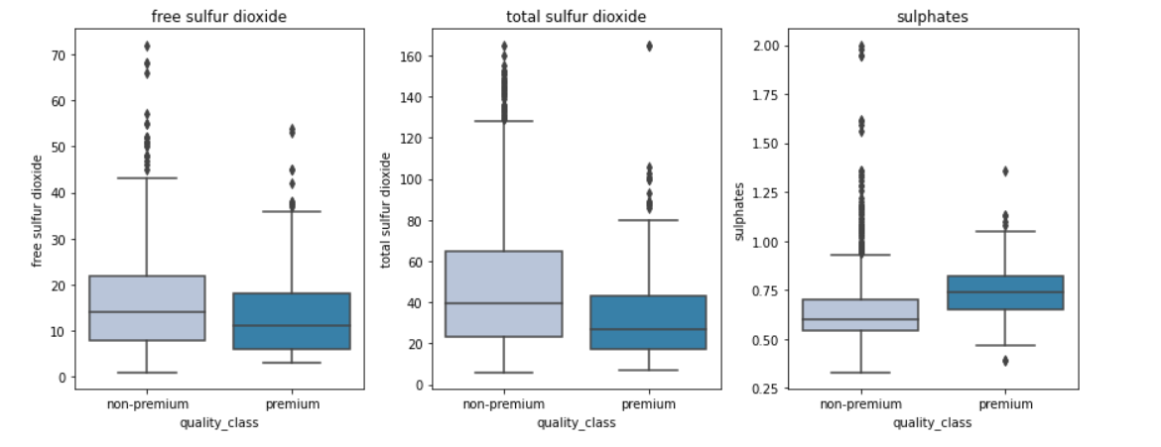
Exploratory Data Analysis (EDA): - Data Insight – Quality vs Acidity / Sulphur
Premium wines have higher fixed acidity and citric acid and lower volatile acidity.
Premium wines have less concentration of free sulfur dioxide and total sulfur dioxide but higher sulphates that helps in preserving them for a longer period.

Slide 18
Model Building Steps and Criteria's

Slide 19
Model Building Steps
Data preparation
Partition the data into train and test set.
Build model on the train data.
Tune the model if required.
Test the data on test set.
Model evaluation criterion
Model can make wrong predictions as:
Which case is more important?

Slide 20
Model Evaluation Criteria
Model can make wrong predictions as:
Predicting a wine is of premium quality when it is of non-premium quality.
Predicting a wine is of non-premium quality when it is of premium quality.
Which case is more important?
1. If the model predicts a wine is of non-premium quality but it is of premium quality then the company would incur loss of good wine and resources used.
2. If the model predicts a wine is of premium quality but it is not then the company would roll out low-quality wine which would affect their customer base and their reputation.
Which metric to optimize?
We would want F1-Score to be maximized, the greater the F1-Score higher the chances of predicting both the classes correctly.

Slide 21
Machine Learning Models

Slide 22
Model Learning Models Researched and Evaluated
K-Nearest Neighbor
Naïve Bayes
Support Vector Machines
Decision Tree
Random Forest
Boosting Classifier
Ada Boost
Gradient Boost
XG Boost
Ensemble Learning / Stacking classifier
Hyperparameter tuning (Grid Search and Random Search)

Slide 23
K-Nearest Neighbor

Slide 24
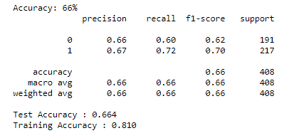
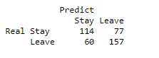
K Nearest Neighbor Algorithm - Model baseline performance
Categorical data encoding: quality column
Split train and test data into 7:3 for model evaluation
Apply standard scaling
Fit default model to train data
Baseline performance:

Slide 25
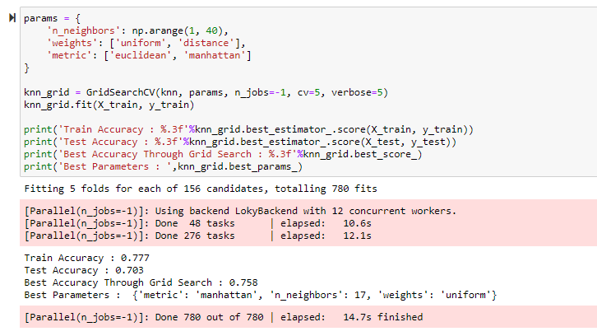
K Nearest Neighbor Algorithm - Hyperparameter tuning with GridSearchCV
The best accuracy after grid search is 75.8%
with metric='manhattan', n_neighbors=17, and weights='uniform'.

Slide 26
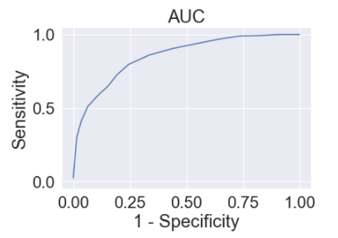
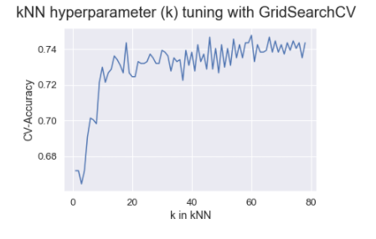
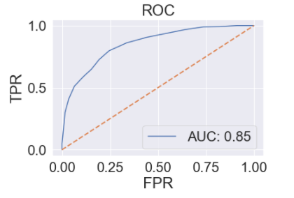
K Nearest Neighbor Algorithm - Model Performance Evaluation
AUC (Area Under Curve)
AUC = 0.8530621389719518

Slide 27
Naïve Bayes

Slide 28
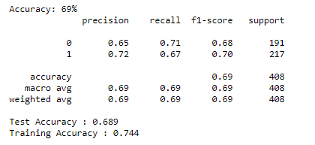
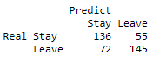
Naive Bayes Classifier Algorithm - With estimator BernoulliNB - Model baseline performance
Categorical data encoding: quality column
Split train and test data into 7:3 for model evaluation
Apply standard scaling
Fit default model to train data
Baseline performance:

Slide 29
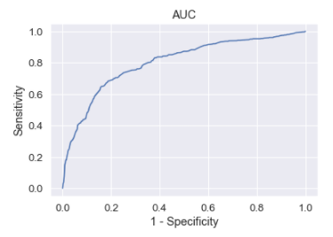
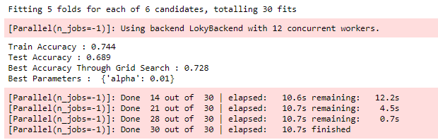
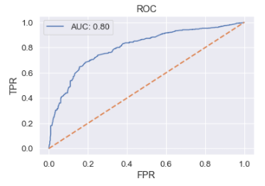
Naive Bayes Classifier Algorithm - With estimator BernoulliNB - Hyperparameter tuning and Evaluation
AUC = 0.8021078270437181
We can get the best accuracy 72.8%
with the best parameter "alpha" 0.01.

Slide 30
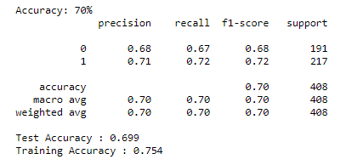
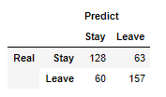
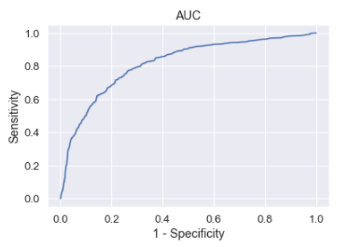
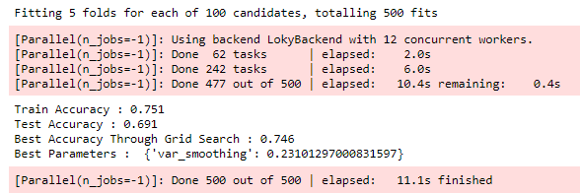
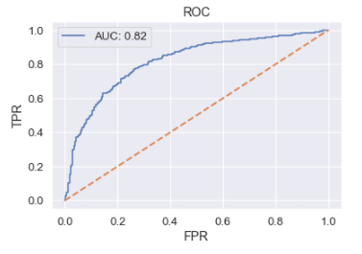
Naive Bayes Classifier Algorithm - With estimator GaussianNB - Hyperparameter tuning and Evaluation
We can get the best accuracy 74.6% with the best parameter "var_smoothing"=0.23101297000831597.

Slide 31
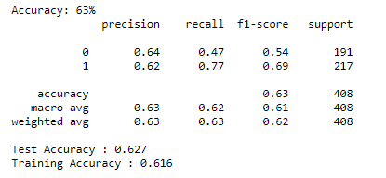
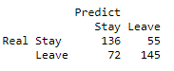
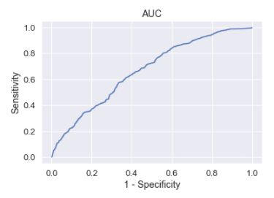
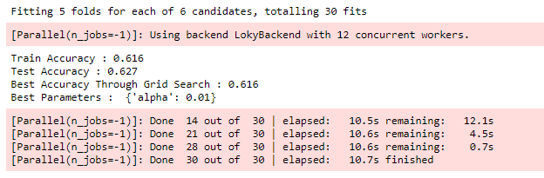
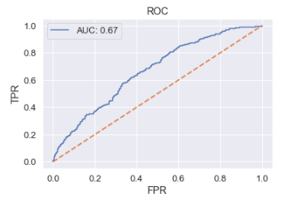
Naive Bayes Classifier Algorithm - With estimator ComplementNB - Hyperparameter tuning and Evaluation
We can get the best accuracy 61.6% with the best parameter "alpha" 0.01.

Slide 32
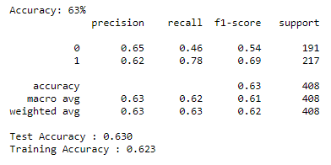
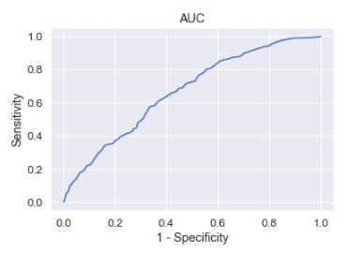
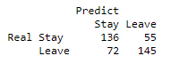
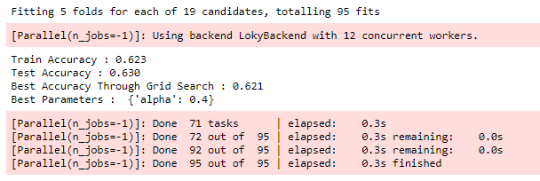
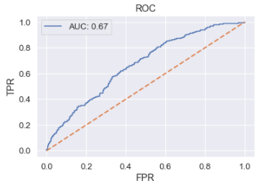
Naive Bayes Classifier Algorithm - With estimator MultinomialNB - Hyperparameter tuning and Evaluation
We can get the best accuracy 62.1% with the best parameter "alpha" 0.4.

Slide 33
Support Vector Machines

Slide 34
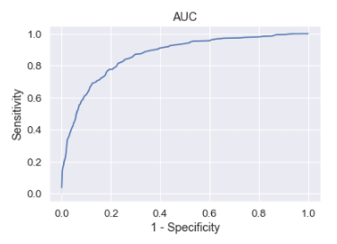
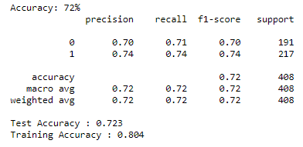



Support Vector Machines Algorithm - Hyperparameter tuning and Evaluation
The best accuracy after grid search is 75.9% with parameters 'C': 10, 'gamma': 0.01, 'kernel': 'rbf'.

Slide 35
Decision Tree

Slide 36

Decision Tree Classifier Algorithm - Model baseline performance
Decision tree is overfitting the training data.
Let's try hyperparameter tuning and see if the model performance improves.

Slide 37

Decision Tree Classifier Algorithm - Hyperparameter tuning and Evaluation
The overfitting has reduced but the test f1-score has also decreased.
Let's try some other models.

Slide 38
Random Forest

Slide 39

Random Forest Classifier Algorithm - Model baseline performance
Random forest is giving slightly higher test f1-score than decision trees but it is overfitting the training data.
Let's try hyperparameter tuning and see if the model performance improves.

Slide 40

Random Forest Classifier Algorithm - Hyperparameter tuning and Evaluation
The overfitting has reduced significantly and the model performance has improved.
The test recall and test f1-score has increased.

Slide 41
Bagging Classifier

Slide 42

Bagging Classifier Algorithm - Model baseline performance
Bagging classifier is overfitting the training data.
Let's try hyperparameter tuning and see if the model performance improves.

Slide 43

Bagging Classifier Algorithm - Hyperparameter tuning and Evaluation
Surprisingly,the model performance has decreased after hyperparameter tuning.
Let's try now try boosting models.

Slide 44
Boosting -AdaBoost -Gradient Boost -XG Boost

Slide 45

AdaBoost Classifier Algorithm - Model baseline performance
Adaboost is giving more generalized performance than previous models but the test f1-score is too low.

Slide 46

AdaBoost Classifier Algorithm - Hyperparameter tuning and Evaluation
The model performance has increased slightly but the model has started to overfit the training data.

Slide 47

Gradient Boosting Algorithm - Model baseline performance
The gradient boosting classifier is overfitting the training data.

Slide 48

Gradient Boosting Algorithm - Hyperparameter tuning and Evaluation
There is not much difference in the model performance after hyperparameter tuning.

Slide 49

XG Boost Algorithm - Model baseline performance
Xgboost classifier is overfitting the training data.
Let's try hyperparameter tuning and see if the model performance improves.

Slide 50

XG Boost Algorithm - Hyperparameter tuning and Evaluation
The overfitting has reduced slightly but there is not much difference in the model performance.

Slide 51
Stacking Classifier (Ensemble learning)

Slide 52

Ensemble Learning (Stacking) - Model baseline performance
The stacking classifier is giving similar performance as compared to XGBoost with slightly less overfitting.
The confusion matrix shows that the model can identify most premium quality wines, but it is better at identifying non-premium quality wines.

Slide 53
Model Comparisons

Slide 54

Comparison of all models
Majority of the models are overfitting the training data in terms of F1-score.
Bagging classifier is giving the highest f1-score on the test data but is overfitting the training data.
The tuned random forest has given the second highest test f1-score and is giving more generalized performance as compared to the bagging classifier.

Slide 55
Feature Importance

Slide 56

Feature Importance of Tuned Random Forest
Alcohol is the most
important feature in
Identifying premium quality
wine followed by sulphates’
and volatile acidity.

Slide 57
Business Recommendations and Insights

Slide 58
Business Recommendations and Insights
Based on our analysis, we can say that the premium quality wine has following features in comparison to the non-premium quality wine:
Higher concentration of alcohol.
A fair and higher concentration of sulphates. Fair indicates smaller range of values or less extreme values.
Less volatile acidity.
Higher fixed acidity.
Higher citric acid concentration.
A fair and lower concentration of total sulfur dioxide and free sulfur dioxide.
Lower concentration of chlorides.
Lesser density.
A fair pH level i.e., neither very acidic or very less acidic.
The company should be more precise with the concentration and level of alcohol, volatile acidity, and sulphates as these are the most important factors in determining the quality of wines. For example, the common alcohol level for the premium quality wine should be between 11-13%.
Once the desired performance is achieved from the model, the company can use it to identify the premium quality wines for new production. This would help to reduce the cost and increase the efficiency of the process.

